Slide 1

Our goal is to raise awareness on the opioid crisis through creating a one-stop shop web application
Display novel social media discourse information through informative visualization using novel AI techniques
Provide nearby resources for those looking for help
OPiate Tracker Using Social media signals and AI
Notes:
Our goal is to create a website that will
Provide information on the opioid crisis through visualizations that utilize AI techniques
Provide resources that are nearby for those looking for help with their addiction

Slide 2
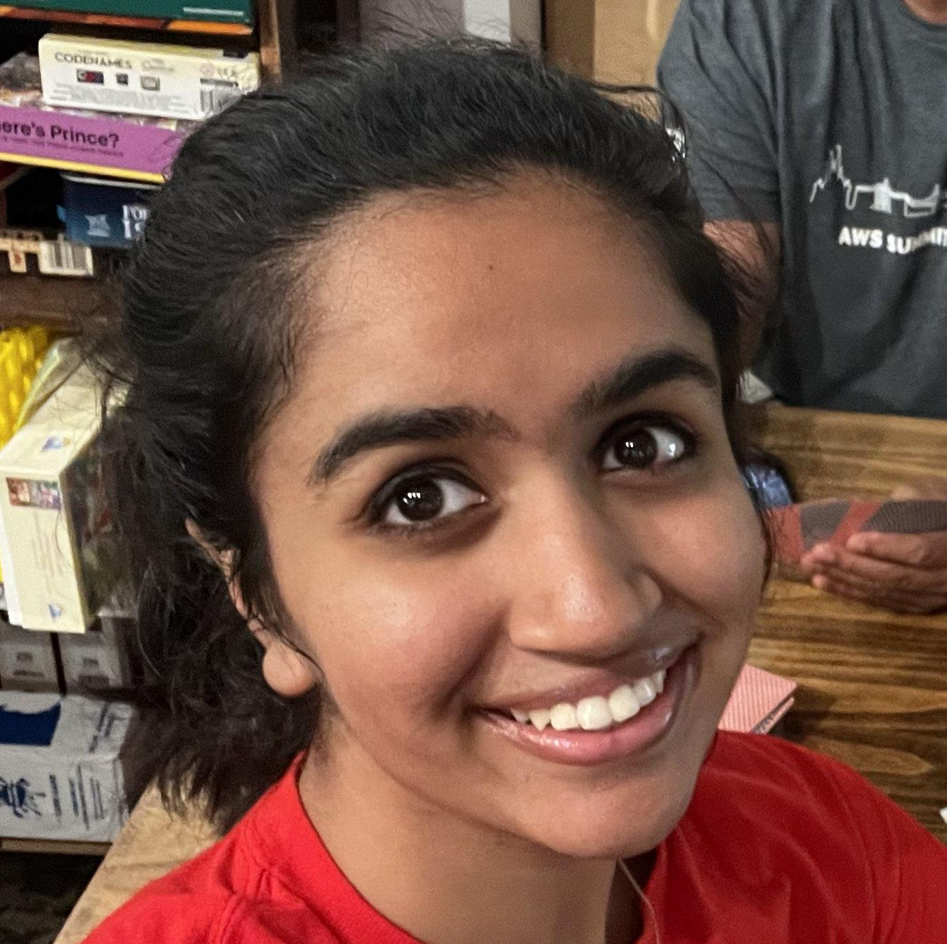


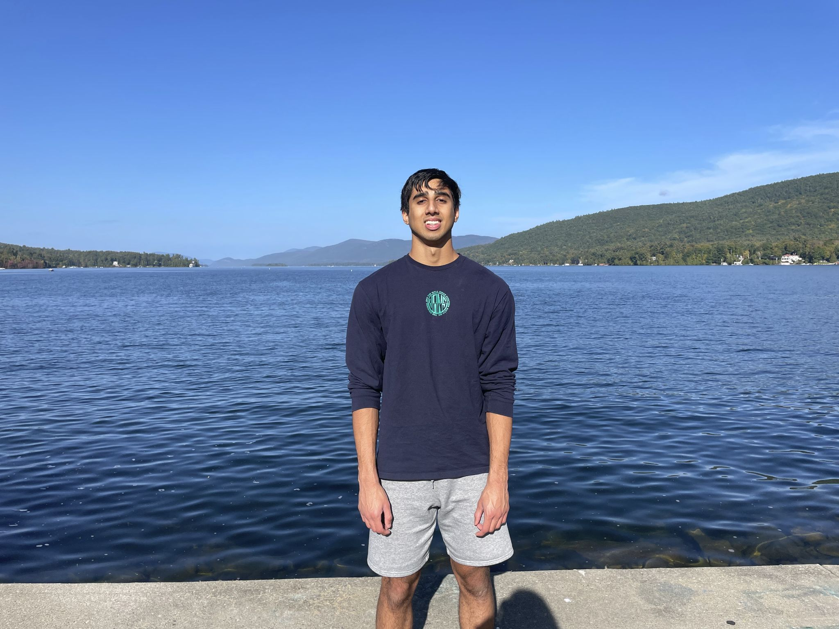



The Team
Ritika Brahmadesam
Yashas Balaji
Kalvin Ramiah
Pranav Rana
Noah Taylor
Analysis
Analysis
Frontend
Scraping
Backend / Scraping
Russell Harter
Prof. Manikonda
Team Lead
Technical Advisor
Notes:
Say person and their role
We’ll get into what everybody did specifically later on

Slide 3



Organization
Communication: In Person / Discord
Primarily through small group meetings
Discord when needed
Website: GitHub
Typical github branch and PR management
Once a visualization was done, it was incorporated into the frontend
Analysis: GitHub
Each person worked on their own branch
They are a “one and done” so they stay on their own branch
Data
Hosted privately on Box

Slide 4










Tech Stack
Analysis
Frontend
Backend
Scraping
Notes:
Frontend is react, material ui, and d3.js
Backend is for more dynamic visualizations and the geolocation feature that we’ll talk about

Slide 5


The Datasets
Reddit
This is a set of data previously gathered by Prof. Manikonda
Contains posts and comments from the r/opiates subreddit
Over 4 million entries spanning from around 2011 to 2020
Very public, high-profile, and active
More controlled and moderated
drugs-forum
Discussion space for all aspects of recovery and drug use(medical and recreational)
Posts provide unique insight from strong community for commonly abused drugs
Users are often highly knowledgeable and openly share personal experiences, harm reduction strategies, addiction support
We aggregated a list of every post related to the 11 most commonly abused opioids

Slide 6
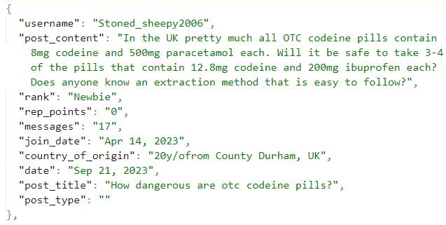
Web Scraping for drugs-forum
Created 11 files containing posts of the most commonly abused drugs that users discuss on drugs-forum
Used Beautiful Soup, a python library to extract HTML data, to collect data for every comment in every post
Dispersed time sleep functions throughout the program to avoid getting IP blocked
Script is designed to be run anywhere, anytime to collect up-to-date information (Can be ran on other subsections of drugs-forum.com)
Plans to host this information privately for future OPTUS-AI analysts
Notes:
Future plans at bottom

Slide 7
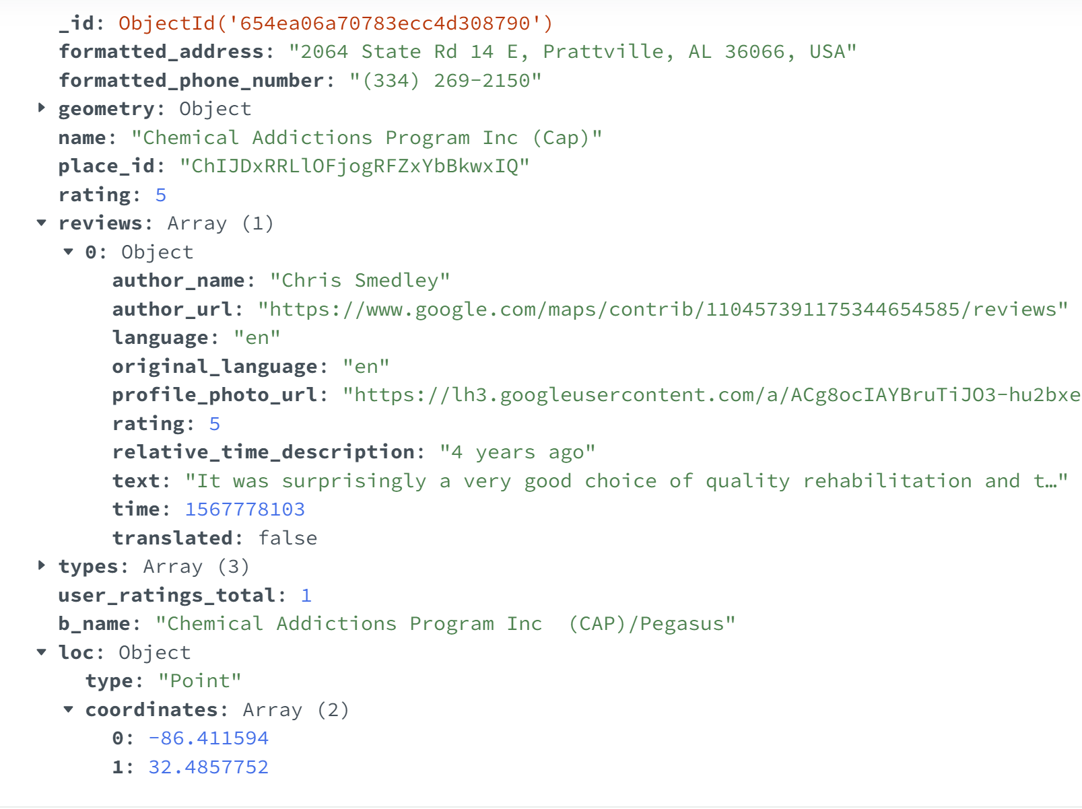
Backend and Geolocation Feature
Powered by FastAPI & MongoDB
Created FastAPI endpoints to access certain rehabilitation centers
Gathered Simple Title/Address set from Sobernation.com
Later retrieved more specific data from Google’s PlacesAPI like Reviews/Coordinates
Engineered feature to match a users given location to the nearest rehabilitation center
Plan to expand upon this feature and match users by also using reviews/ratings
Example Entry in Database

Slide 8
Natural Language Processing (NLP) Techniques
NLP is a branch of Artificial Intelligence that focuses on language
Common base elements:
Tokenization: Splits sentences into tokens, most commonly words
Part-of-speech tagging: Identifies nouns, verbs, adjectives, etc.
Named Entity Recognition: Identifies entities such as people or locations
Example: "Yesterday, Sarah and John traveled to Paris for a business meeting."
Tokenization
["Yesterday", ",", "Sarah", "and", "John", "traveled", "to", "Paris", "for", "a", "business", "meeting", "."]
Part-of-speech tagging
["Yesterday"(Noun), ","(Punctuation), "Sarah"(Proper Noun), "and"(Conjunction)...]
Named Entity Recognition
"Yesterday"(Date), "Sarah"(Person), "John"(Person), "Paris"(Location), "business meeting"(Event)]

Slide 9
Two Main NLP Techniques Used
Sentiment Analysis
Topic Modeling
Identifies and categorizes opinions in text, quantifying the writer’s opinion from very negative (-1) to very positive (1)
Is rule-based
Real examples from Reddit comments:
“Looks awesome” -> 1
“Works brilliantly with the jitters, and fleeting heart feeling.” -> 0.9
“Too bad I don't have any :(“ -> -0.725
“migraines are f****** awful” -> -1
Topic modeling is used to uncover abstract topics within a collection of documents
This is NOT topic classification
Topic are generated only from text instead of being assigned to pre-made topics
Utilizes more advanced steps:
Make sentence embeddings
Turns sentences into vectors of numbers
Cluster the vectors
Groups embeddings into distinct clusters
Interpret and weight those clusters into topics
Notes:
This and managing the team is what I spent most of my time on
Natural Language Processing or NLP
NLP is a branch of Artificial Intelligence that focuses on language
SA
in the -1 example, “fucking” modifies “awful” to make it so negative

Slide 10
Topic Modeling Example
Notes:
This is calculated from the 127k rows that we scraped
I used a cloud GPU to calculate this

Slide 11
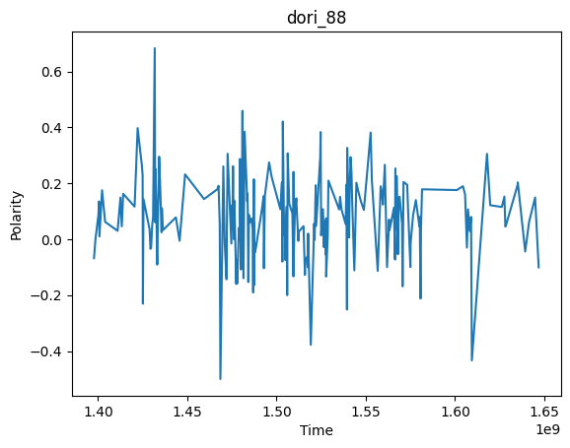
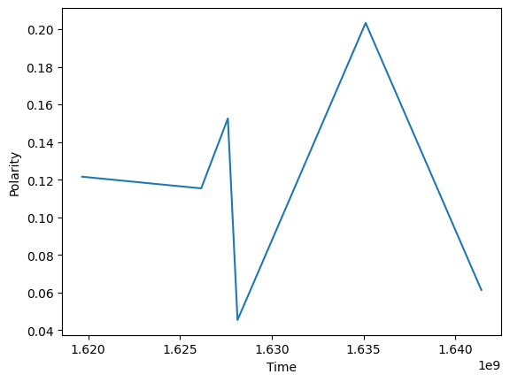
Significant Users
In the reddit data, we used upvotes and number of posts to curate a list of the active and liked members of the community
We chose a few of the most significant members for their story to show how social media discourse can help people
Plotted sentiment of their these user’s significant posts over time to hopefully show a positive trend
Originally we plotted all post’s sentiment over time but found that plotting significant moments showed a better trend

Slide 12
Ritika’s Analysis
Tracking Most Common Words Over Time
BERTopic Over Time
Clean Submissions Data
Sample data
Clean formatting of the data (punctuation, stop words, etc.)
Clean formatting of the data
(stop words)
Track number of words over years, store data as JSON
Run BERTopic over sampled data, generate HTML output

Slide 13
Demo

Slide 14
Thank you!
Questions?
Notes:
I think we did a great job for a single semester’s worth of work
Future work
More visualizations
A more fleshed-out geolocation feature
Better formatting
Hosting

